Slide 1

Exercise 5: Swing Chat

Slide 2
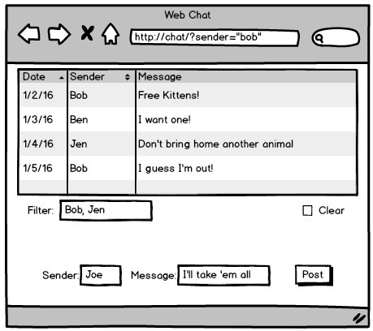
Exercise 5: Swing Chat
Create a Swing application for your CorkBoardImpl server from module 2. You may embed the Impl directly into your application, or you may connect to a remote RMI server!
The previous web interface design is shown here for reference. Your swing look and feel may be completely different, but the functionality should be similar.
Optional: Use a JTable for the posted content.
Optional: Launch all three clients (console, web, and swing) with the same RMI server instance.

Slide 3
Hints
Design your GUI – components and layout – on paper. How does the layout respond to resizing?
Experiment with the GUI from inside of “main”. Then later move the GUI code to its final destination.
Develop your application with the CorkBoardImpl object right inside your code. You can substitute the RMI client stub later.

